Slide 1
British Airways
Customer Feedback Analysis

Slide 2
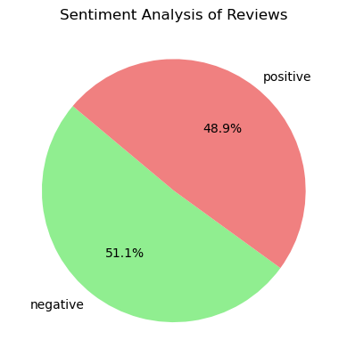
Insights drawn after web scrapping
After Topic Modelling, we found:
Topics for which we got negative feedback: London, Ticket, Refund, Economy, Poor, Luggage, Baggage, Cancellation Service, Arrival, Late.
Topics for which we got positive feedback: Cabin crew, staff, meal, lounge, food, seats, entertainment, business service.
This tells us a lot about the services customers are happy with and the services British Airways needs to improve.

